Slide 1
Tata project1
File created on: 11/1/22 10:16:30 PM PDT

Slide 2
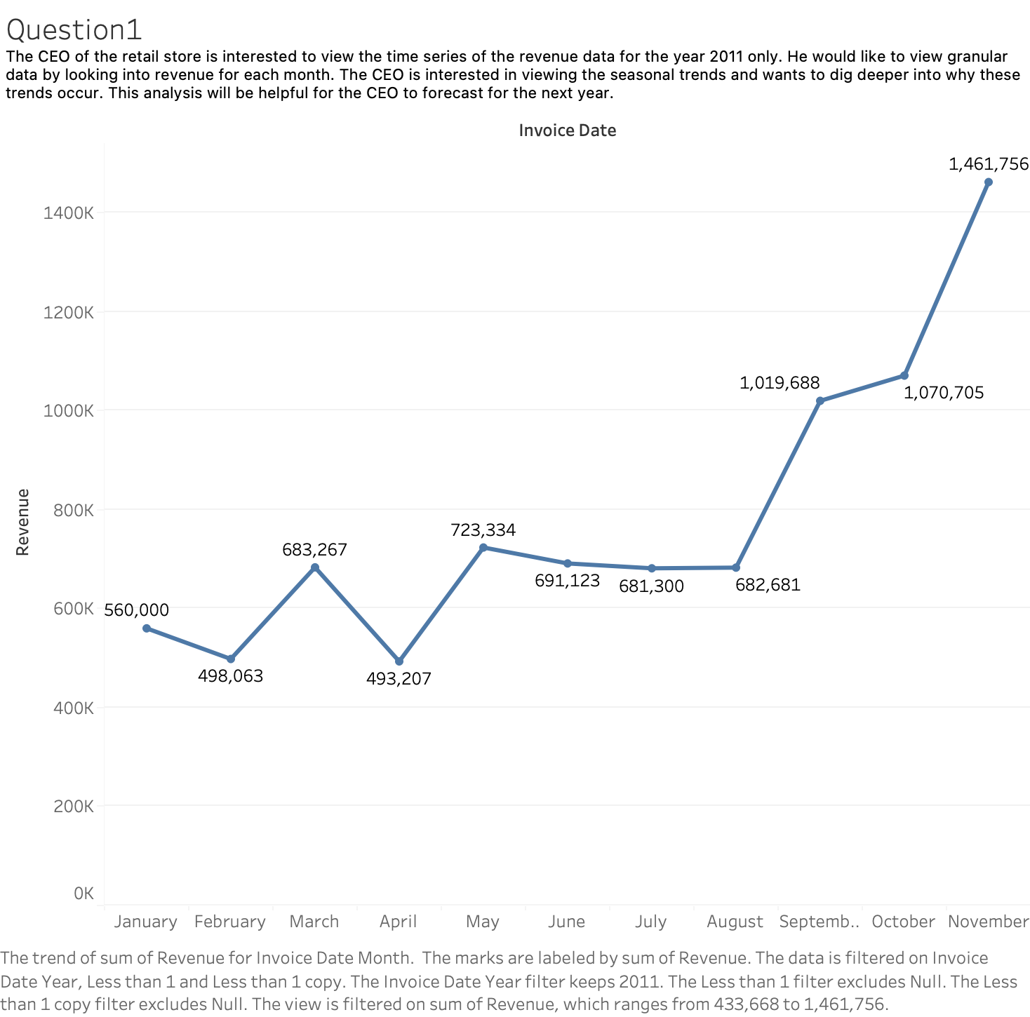

Slide 3
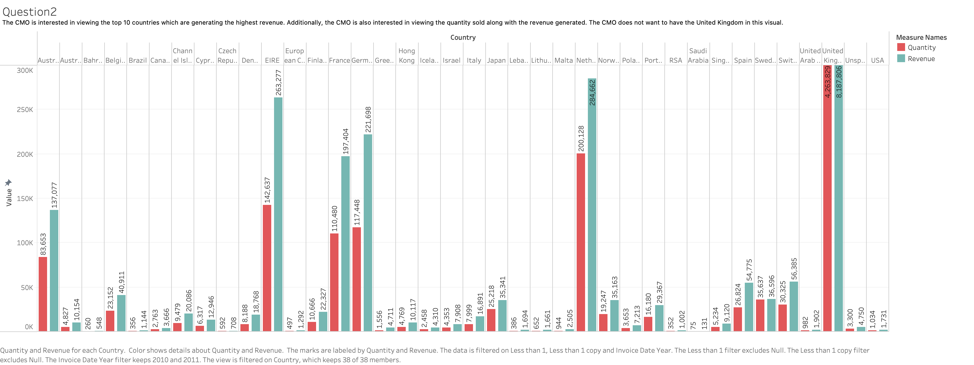

Slide 4
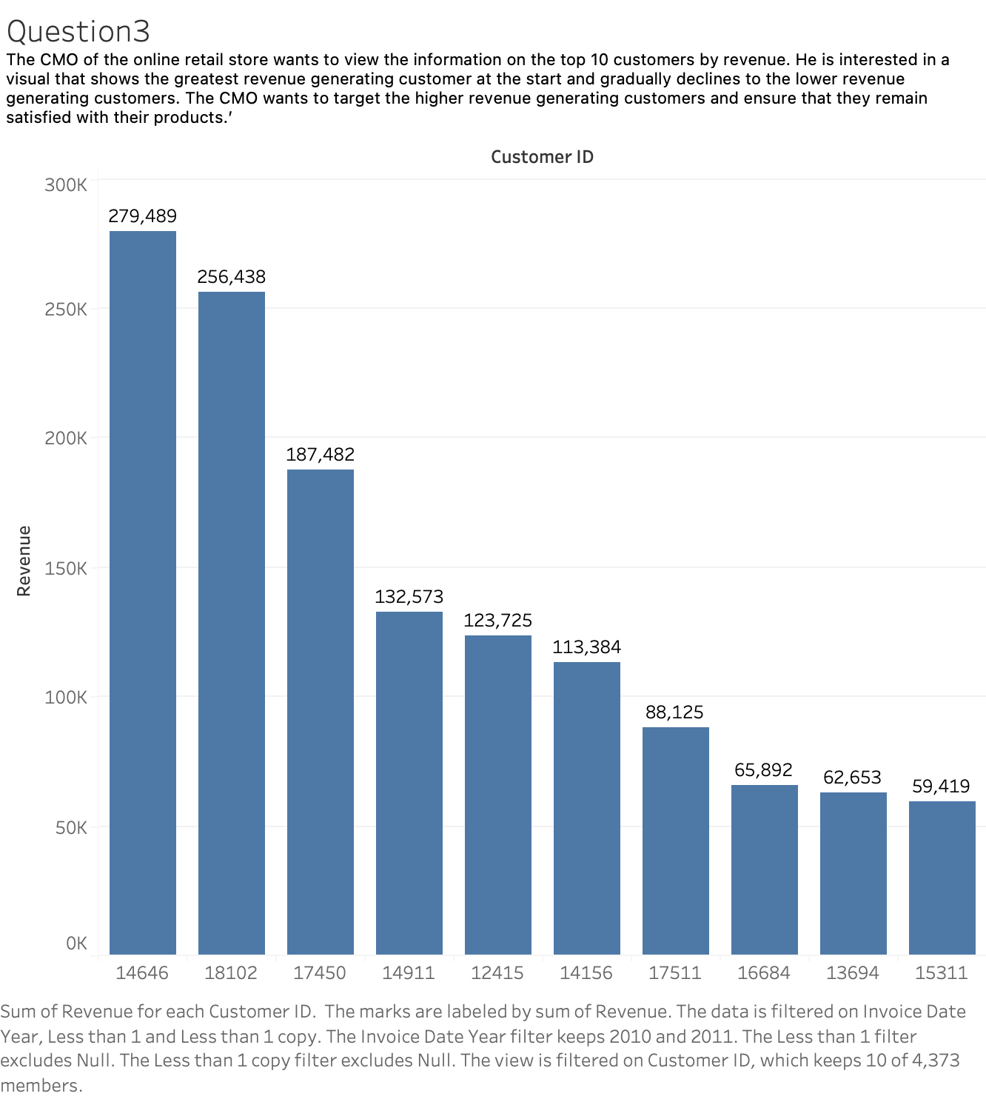

Slide 5
